Slide 1


Slide 2
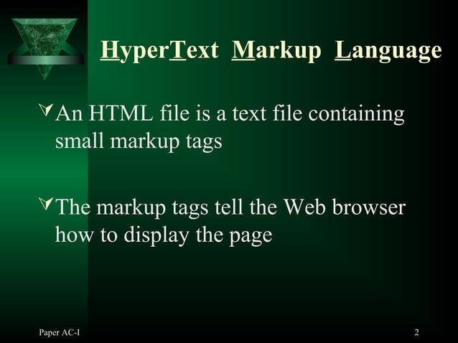

Slide 3
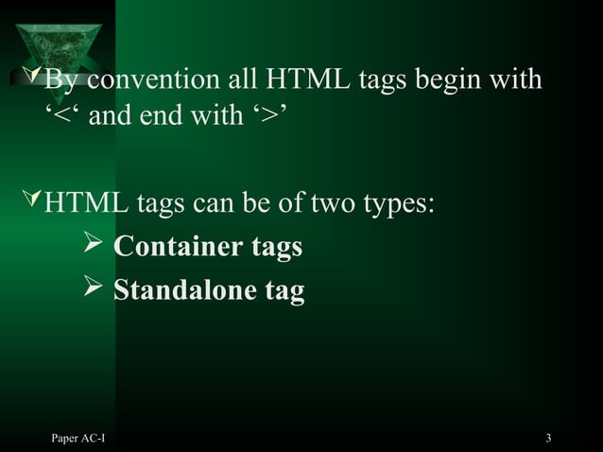

Slide 4
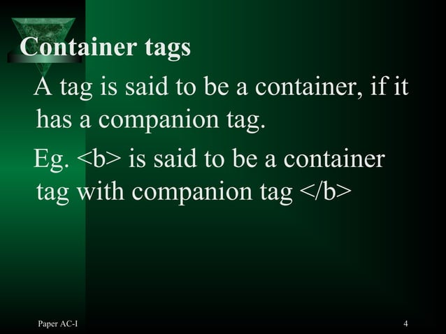

Slide 5
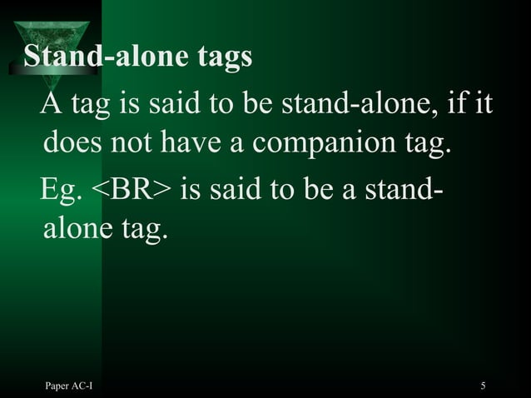

Slide 6
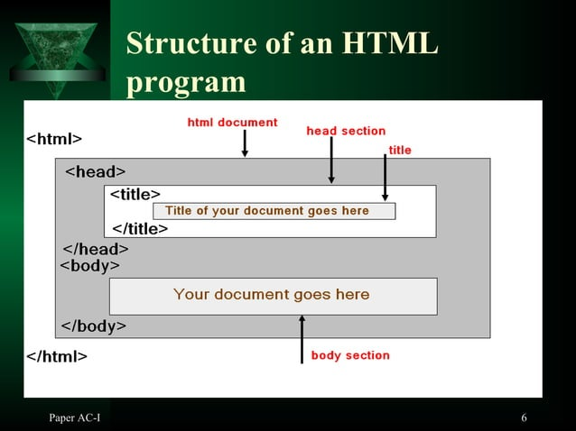

Slide 7
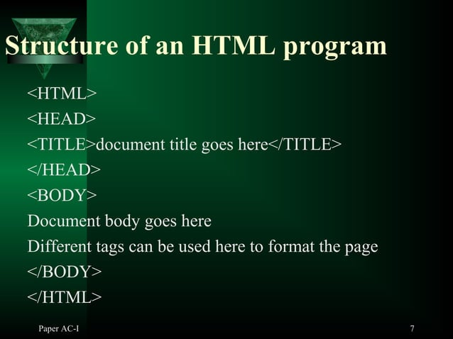

Slide 8
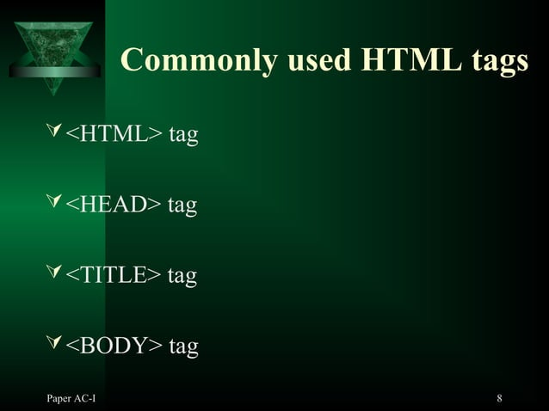

Slide 9
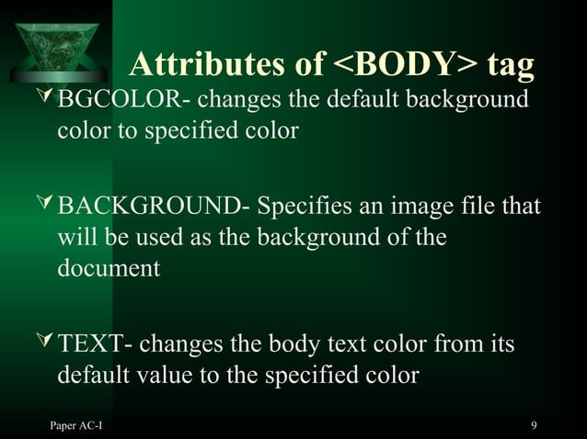

Slide 10
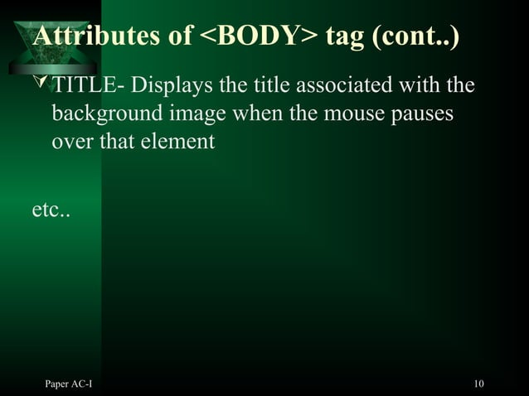

Slide 11
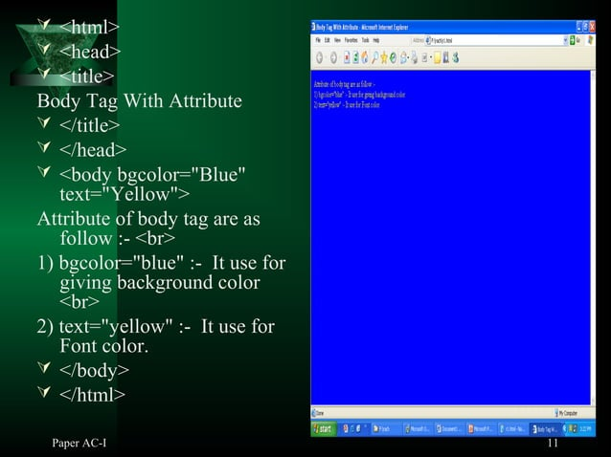

Slide 12
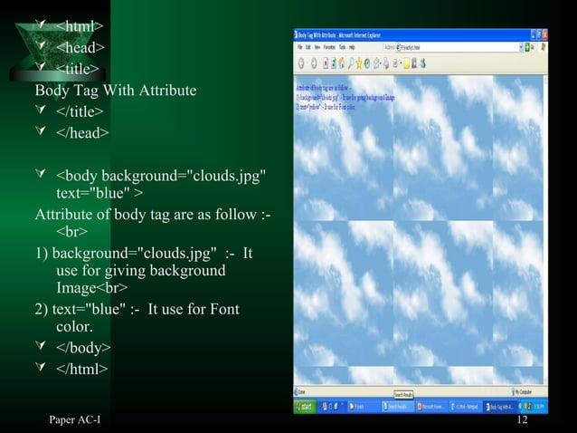

Slide 13


Slide 14
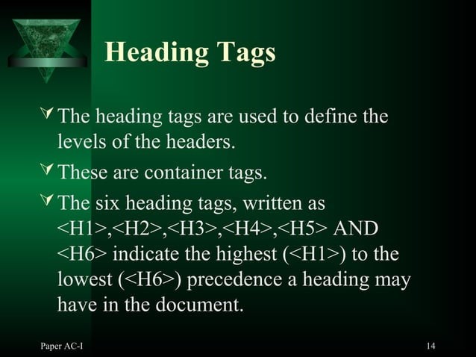

Slide 15
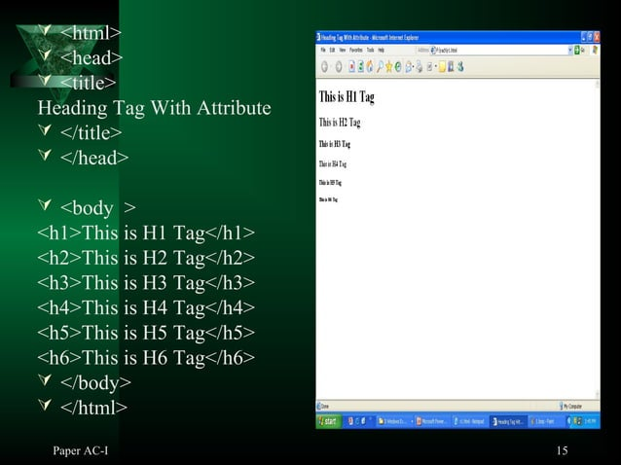

Slide 16
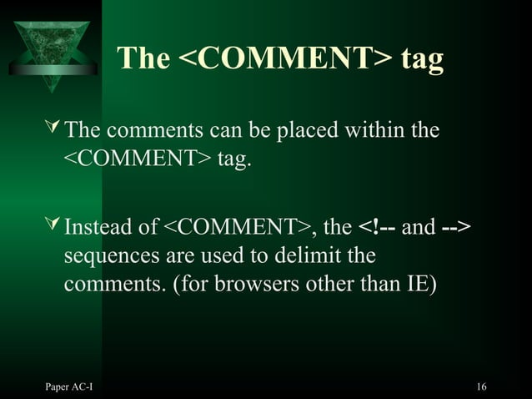

Slide 17


Slide 18
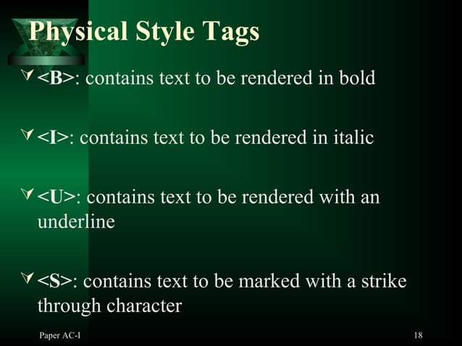

Slide 19
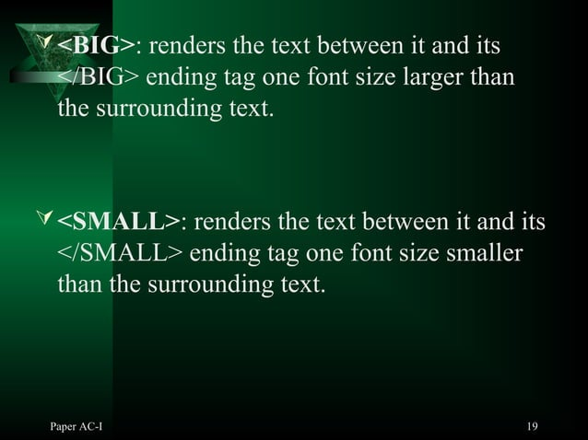

Slide 20
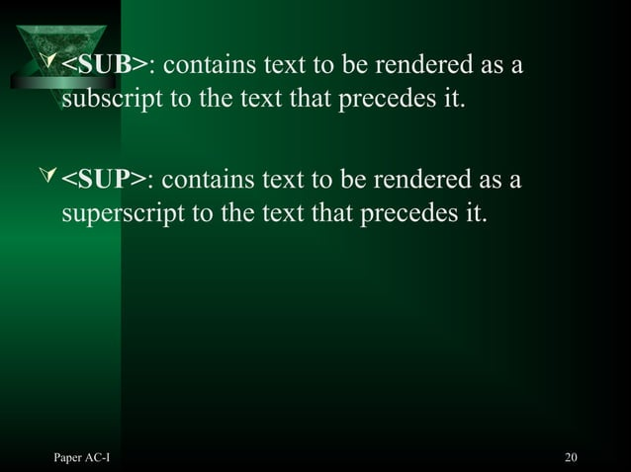

Slide 21
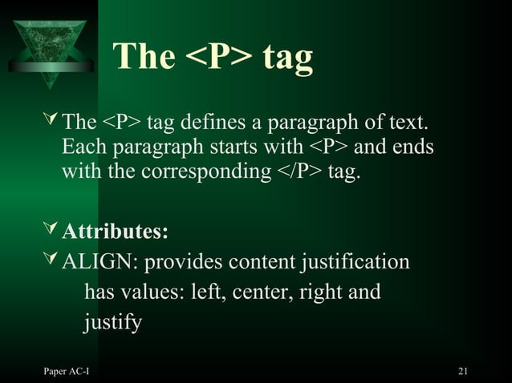

Slide 22
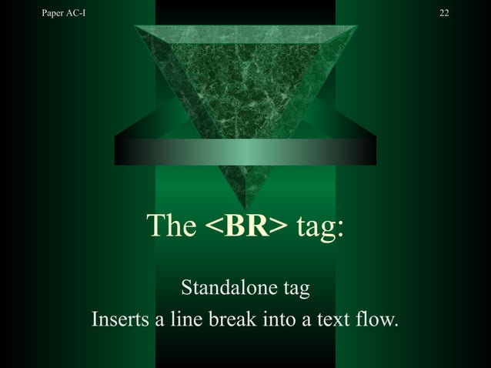

Slide 23
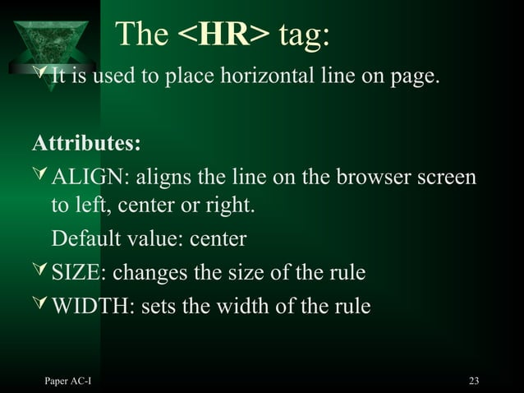

Slide 24
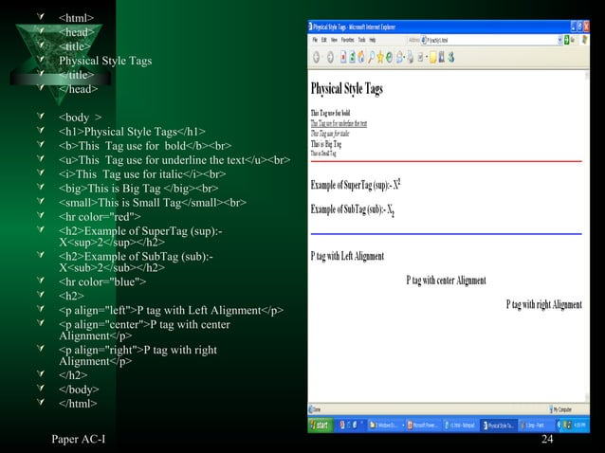

Slide 25


Slide 26
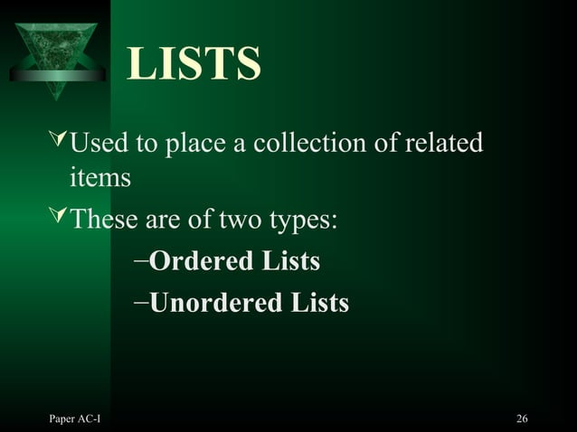

Slide 27
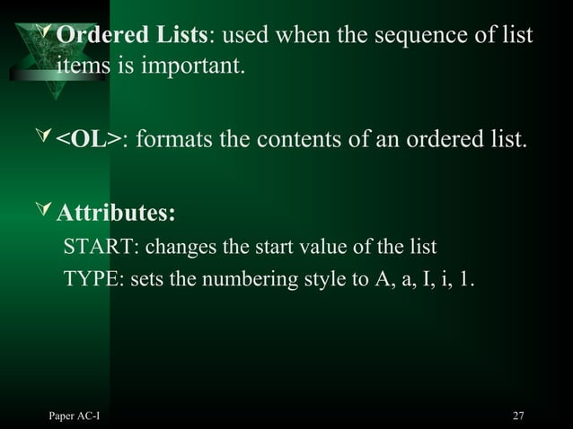

Slide 28
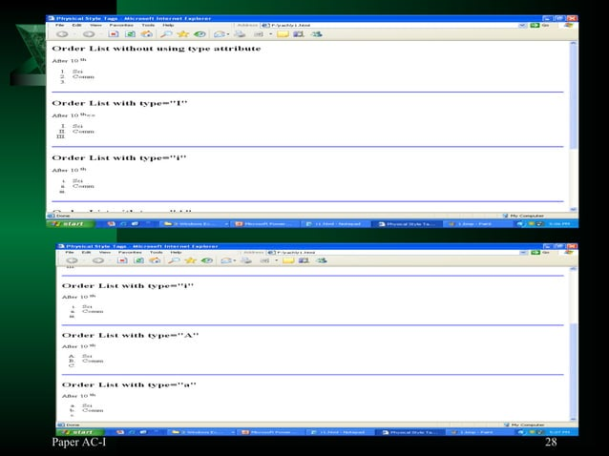

Slide 29
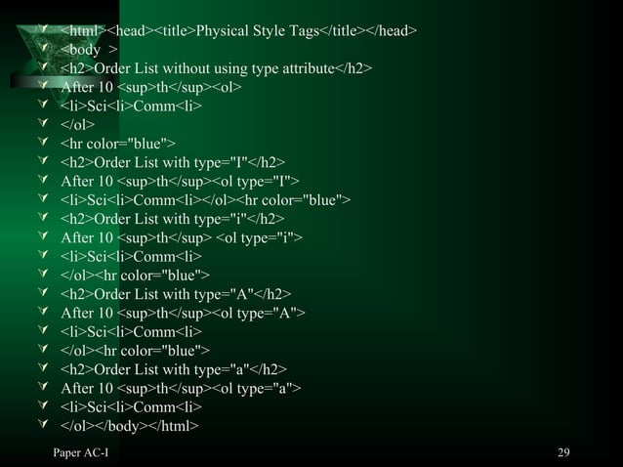

Slide 30
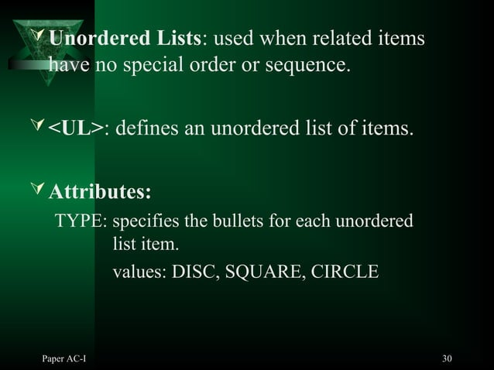

Slide 31
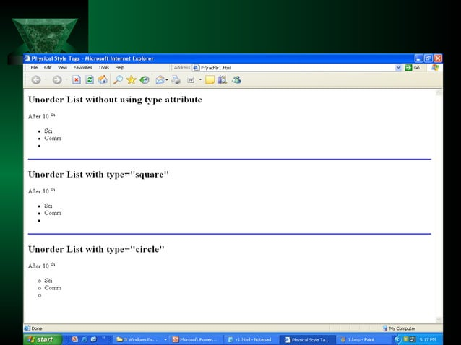

Slide 32
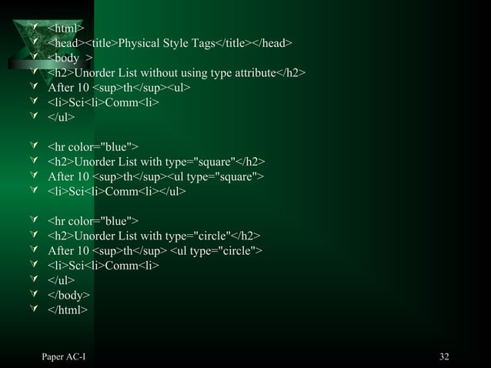

Slide 33
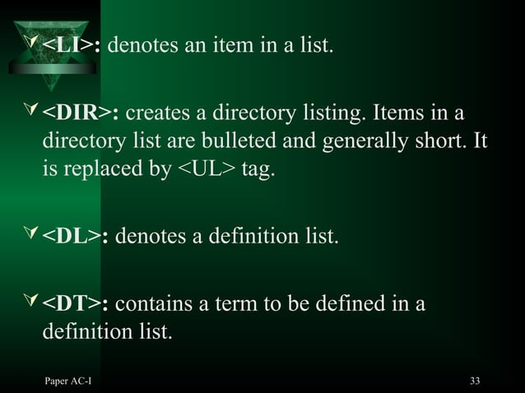

Slide 34
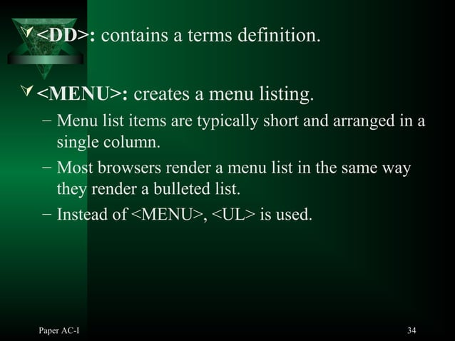

Slide 35
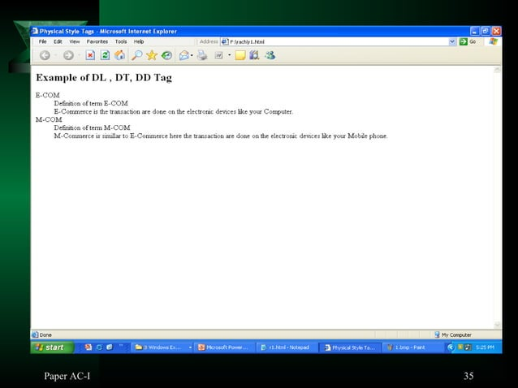

Slide 36
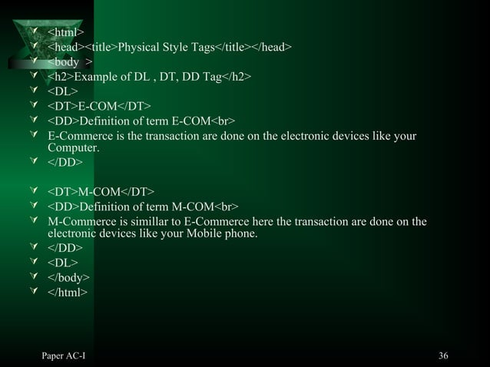

Slide 37
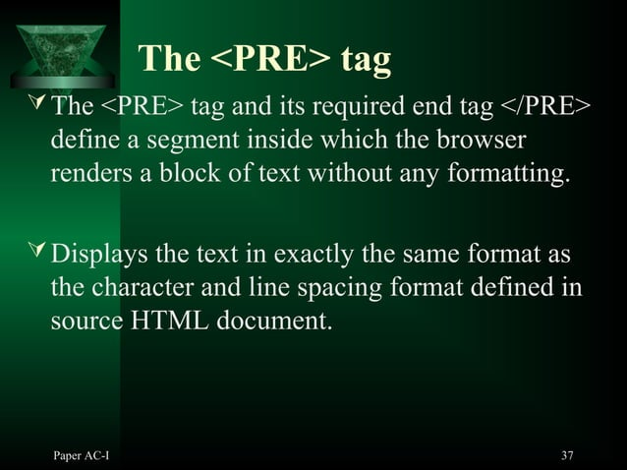

Slide 38
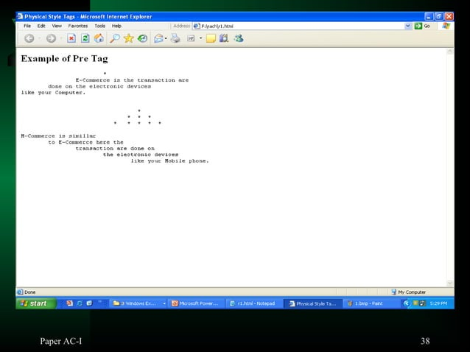

Slide 39
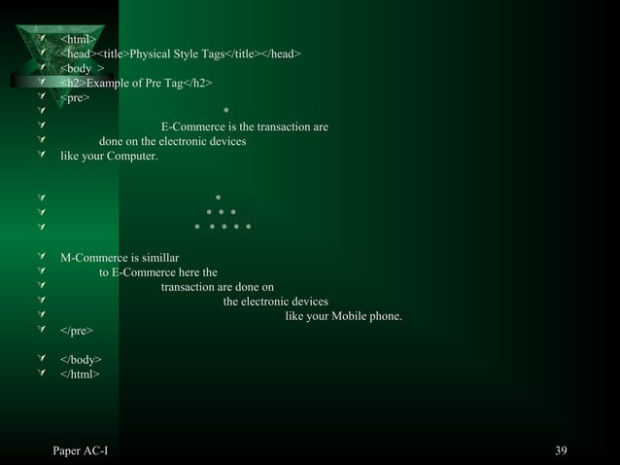

Slide 40


Slide 41
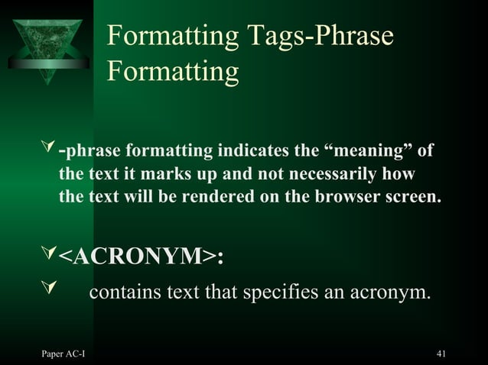

Slide 42
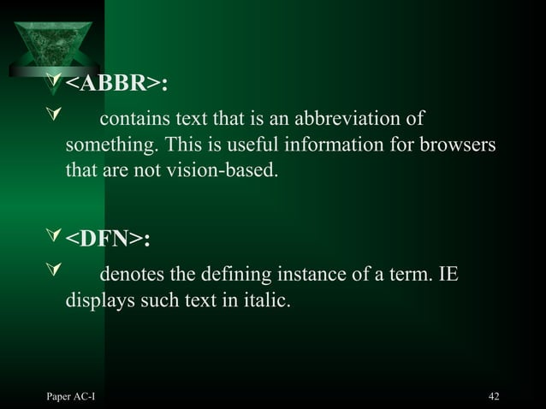

Slide 43
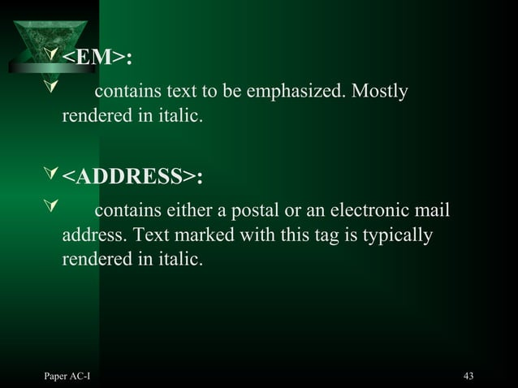

Slide 44
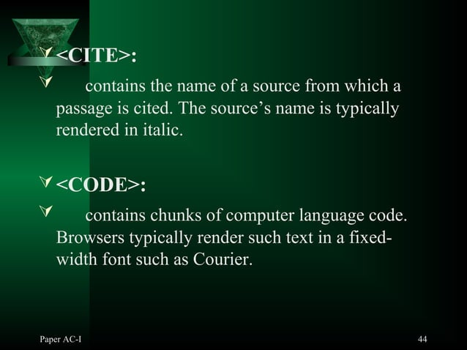

Slide 45


Slide 46
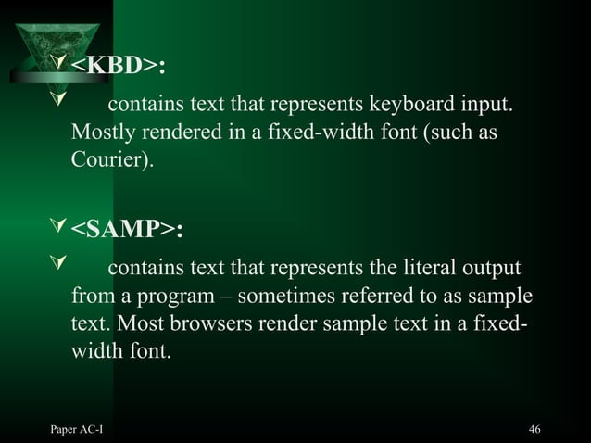

Slide 47
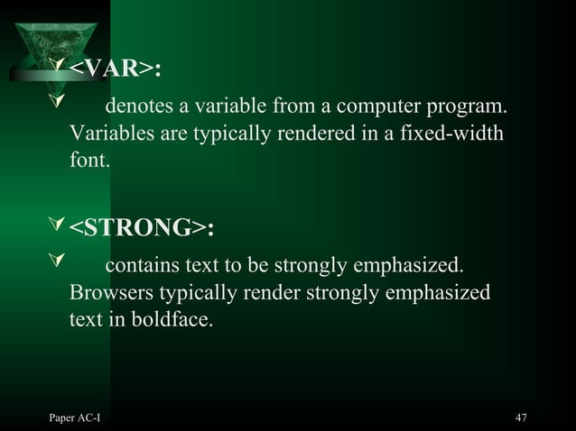

Slide 48


Slide 49
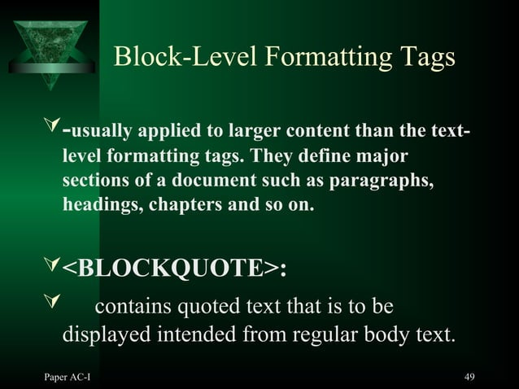

Slide 50
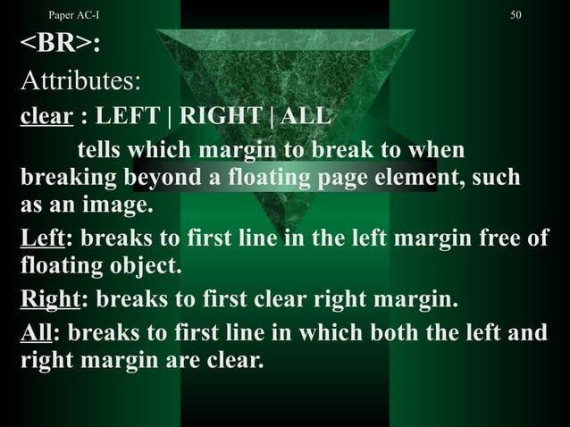

Slide 51
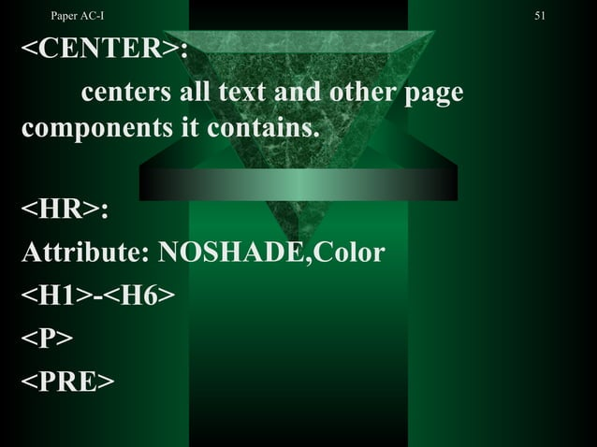

Slide 52


Slide 53
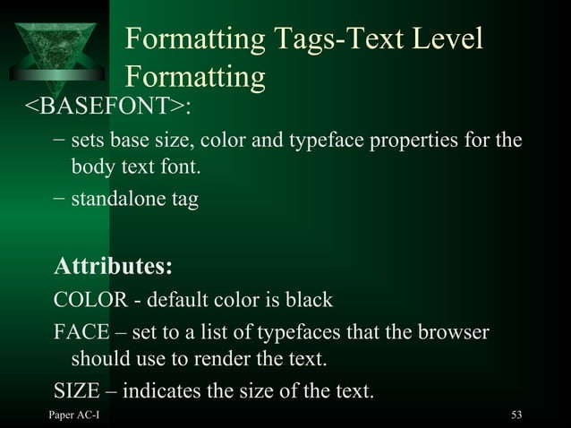

Slide 54
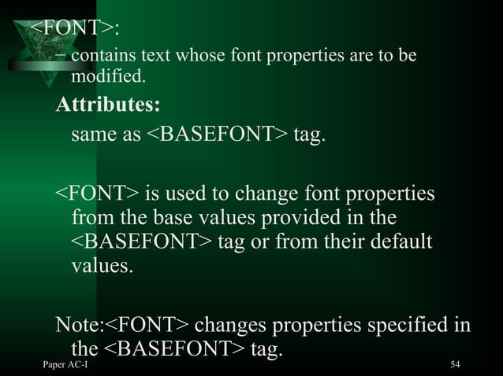

Slide 55
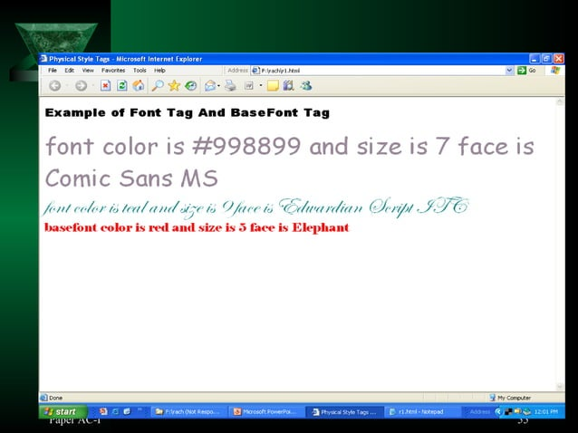

Slide 56
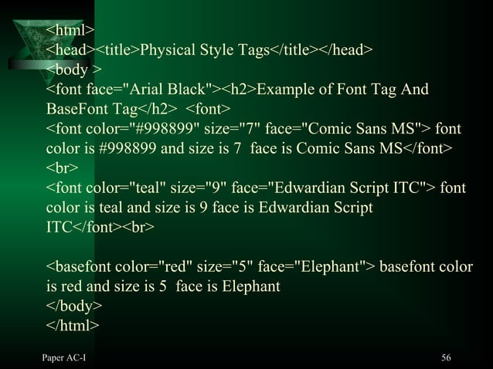

Slide 57
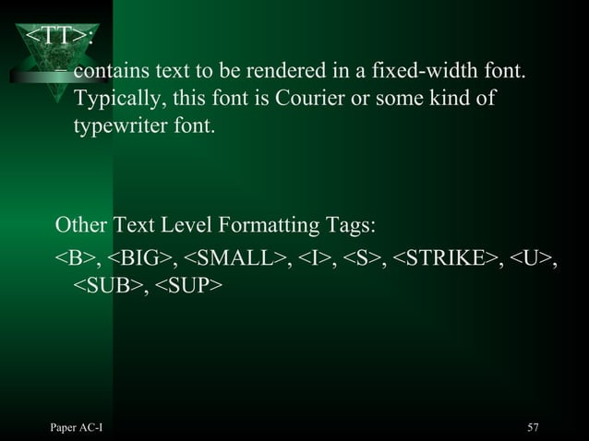

Slide 58


Slide 59
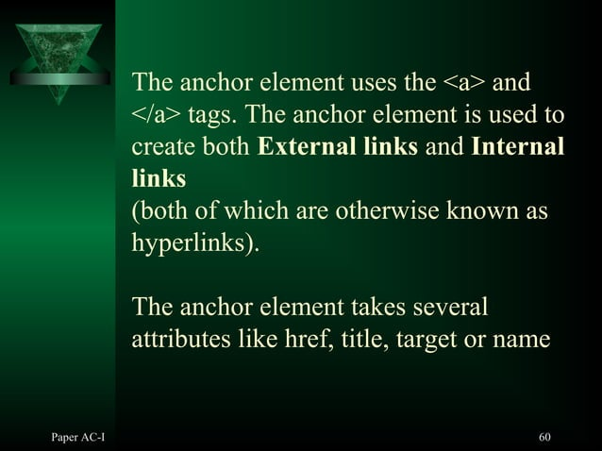

Slide 60


Slide 61


Slide 62


Slide 63


Slide 64


Slide 65


Slide 66


Slide 67


Slide 68


Slide 69


Slide 70


Slide 71


Slide 72


Slide 73


Slide 74


Slide 75


Slide 76


Slide 77


Slide 78


Slide 79


Slide 80


Slide 81


Slide 82


Slide 83


Slide 84


Slide 85


Slide 86


Slide 87


Slide 88


Slide 89


Slide 90


Slide 91


Slide 92


Slide 93


Slide 94


Slide 95


Slide 96


Slide 97


Slide 98


Slide 99


Slide 100


Slide 101


Slide 102


Slide 103


Slide 104


Slide 105


Slide 106


Slide 107
HTML Form
An HTML form is a document section containing controls such as text fields, password fields, checkboxes, radio buttons, submit buttons, menus, etc.
An HTML form facilitates the user to enter data that is to be sent to the server for processing such as name, email address, password, phone number, etc..
Syntax
<form action="server url" method="get|post">
//input controls e.g. textfield, textarea, radiobutton, button </form>

Slide 108

<input> element
The HTML <input> element is a fundamental form element.
It is used to create form fields and to take input from user.
We can apply different input fields to gather different
information from users. Following is the example to
show the simple text input.
Example:
<body> o/p:
<form>
Enter your name <br>
<input type="text" name="username">
</form>
</body>

Slide 109

TextField Control
<form>
First Name: <input type="text" name="firstname"/> <br/>
Last Name: <input type="text" name="lastname"/> <br/>
</form>
o/p:

Slide 110

<textarea> tag in form
<!DOCTYPE html>
<html>
<head>
<title>Form in HTML</title>
</head>
<body>
<form>
Enter your address:<br>
<textarea rows="2" cols="20"></textarea>
</form>
</body>
</html>

Slide 111


Password Field Control
<form>
<input type="password" name="password"/> <br/>
</form>
Email Field Control
<form>
<input type="email" name="email"/> <br/>
</form>

Slide 112

Radio Button Control
The radio button is used to select one option from multiple options. It is used for selection of gender, quiz questions etc.
<form>
<input type="radio" name="gender" value="male"/>Male
<input type="radio" name="gender" value="female"/>Female <br/>
</form>

Slide 113

Checkbox Control
<form>
Hobby:<br>
<input type="checkbox" id="cricket" name="cricket" value="cricket"/>
<label for="cricket">Cricket</label> <br>
<input type="checkbox" id="football" name="football" value="football"/>
<label for="football">Football</label> <br>
<input type="checkbox" id="hockey" name="hockey" value="hockey"/>
<label for="hockey">Hockey</label>
</form>

Slide 114

Submit button control
HTML <input type="submit"> are used to add a submit button on web page. When user clicks on submit button, then form get submit to the server.
<input type="submit" value="submit">
<form>
<input type="text" name="name"><br>
<input type="Password" name="pass"><br>
<input type="submit" value="submit">
</form>

Slide 115
Example:
<body>
<form action= "https://www.google.com/">
Enter your name <br>
<input type="text" name="username"> <br> <br>
First Name: <input type="text" name="firstname"> <br> <br>
Last Name: <input type="text" name="lastname"> <br> <br>
Enter your address:<br>
<textarea rows="2" cols="20"></textarea> <br><br>
Email : <br><br>
<input type="email" name="email"> <br> <br>

Slide 116
Password:<br>
<input type="password" name="password"> <br> <br>
Gender :<br>
<input type="radio" name="gender" value="male">Male
<input type="radio" name="gender" value="female">Female <br/>
Hobby:<br>
<input type="checkbox" name="cricket" value="cricket"> Cricket
<br>
<input type="checkbox" name="football" value="football"> Football
<br>
<input type="checkbox" name="hockey" value="hockey"> Hockey <br> <br>
Enter Color:
<input type="color" name="color"> <br><br>

Slide 117
Selcet Country :
<select name="country"><br>
<option value="india">india</option>
<option value="pakistan">pakistan</option>
<option value="africa">africa</option>
<option value="china">china</option>
<option value="other">other</option>
</select> <br><br>
Date: <br>
<input type="date" name="date" > <br> <br>
Time:<br>
<input type="time"> <br> <br>
<input type="reset" value="reset"> <br><br>
<input type="submit" value="submit"> <br><br>
</form>
</body>

Slide 118


Slide 119


Slide 120


Slide 121


Slide 122


Slide 123


Slide 124


Slide 125


Slide 126


Slide 127


Slide 128


Slide 129


Slide 130


Slide 131


Slide 132


Slide 133


Slide 134


Slide 135


Slide 136


Slide 137


Slide 138


Slide 139


Slide 140


Slide 141


Slide 142


